Slide 1
RISK PREDICTION DURING PREGNANCY
Metronomic Health
Team Name: Baby In Nine
Date: 05/09/23

Slide 2



ENDORSEMENT
Dr. Sujith Krishnan
Dr. Reyna Rollins
Dr. Sujith Krishnan is a Medical Doctor with diverse experience, including working in the socialistic traditions of the NHS.
Pursued an MBA at the prestigious London Business School after obtaining his medical degree from JIPMER.
Dr. Reyna Rollins is an experienced and results-driven leader in enterprise security program management
works with government agencies to enhance their security posture and maximize their return on investment.

Slide 3
01 INTRODUCTION
02 DATASETS
03 ARCHITECTURE /ALGORITHMS
04 VISUALIZATIONS
05 KEY FINDINGS
06 FUTURE WORK
AGENDA

Slide 4

INTRODUCTION

Slide 5







TEAM MEMBERS
Arthi Kotha Developer and Quality Manager
Srikar Jindam Developer
Anish Reddy Vakiti Developer
Prashant Vajjala Venkata Naga Developer
Shubham Khaladkar Product Owner
Yashwanth Reddy Gouni Scrum Master

Slide 6
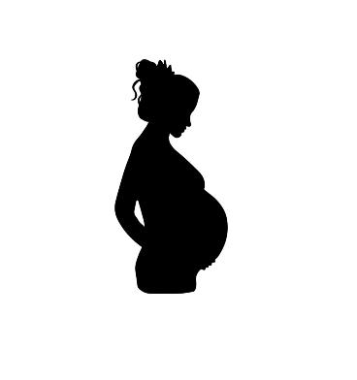
PROBLEM STATEMENT
Problem Context
The domain of problem: Health (pregnancy).
Importance of problem: Improve planning and being informed about the problem by sharing information with the doctors. The babies fall at risk without these trimester
Problem Statement
Comorbid conditions can result in significant challenges during pregnancy, causing harm to both the mother and baby. Early detection of potential complications using AI models based on historical data can help minimize these difficulties by allowing prompt and appropriate interventions to be implemented complications.
Project Goal
Using a developed machine learning algorithm to predict the risks at the end of the first trimester using the patient's historic data. The main goal is to focus on the five initial objectives. Analyzing and observing to predict the risks during pregnancy.

Slide 7
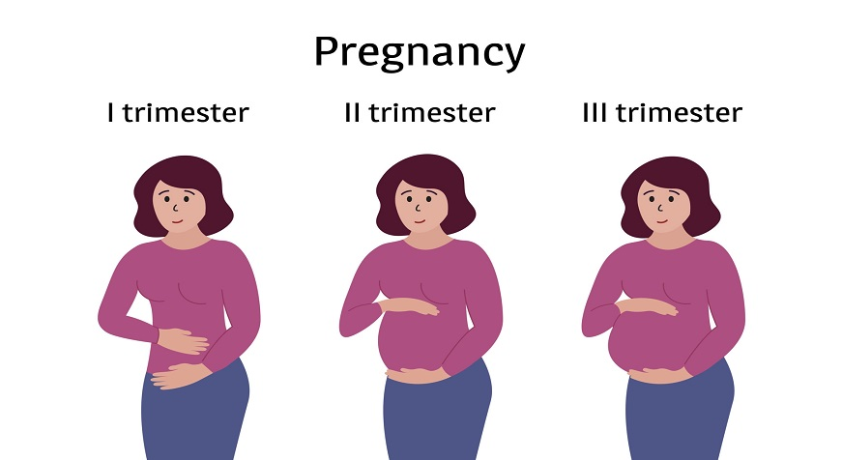
BACKGROUND
Pregnancy Duration : 40 WEEKS
The length of a pregnancy is generally considered to be 40 weeks, or 280 days, although it can vary by a few days in either direction
First Trimester: Up to 13 weeks
Nausea and Vomiting at any time
Fatigue
Swollen Breasts
Second Trimester: 14 weeks to 27 weeks
Pain in abdomen
Feeling lightheaded
Third Trimester: 28 weeks till labor
Shortness of breath
Frequent urination

Slide 8
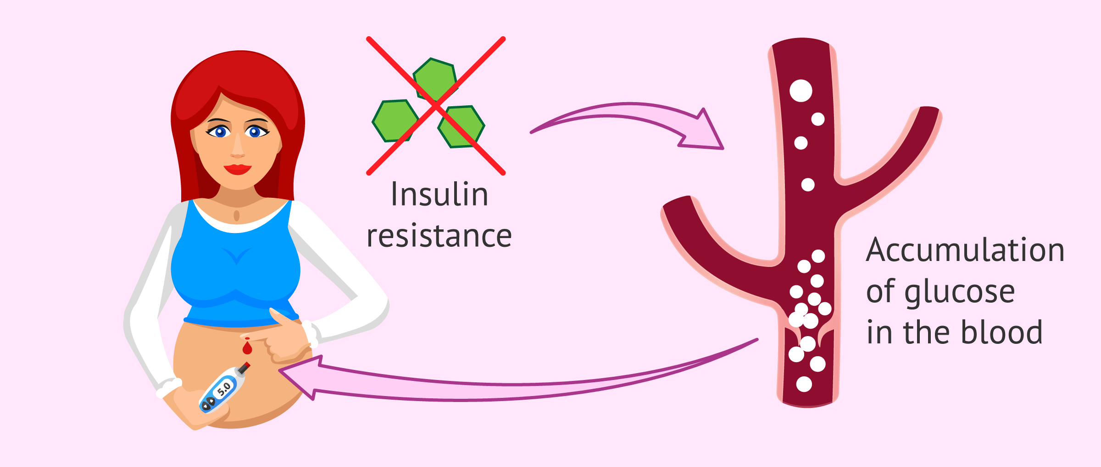
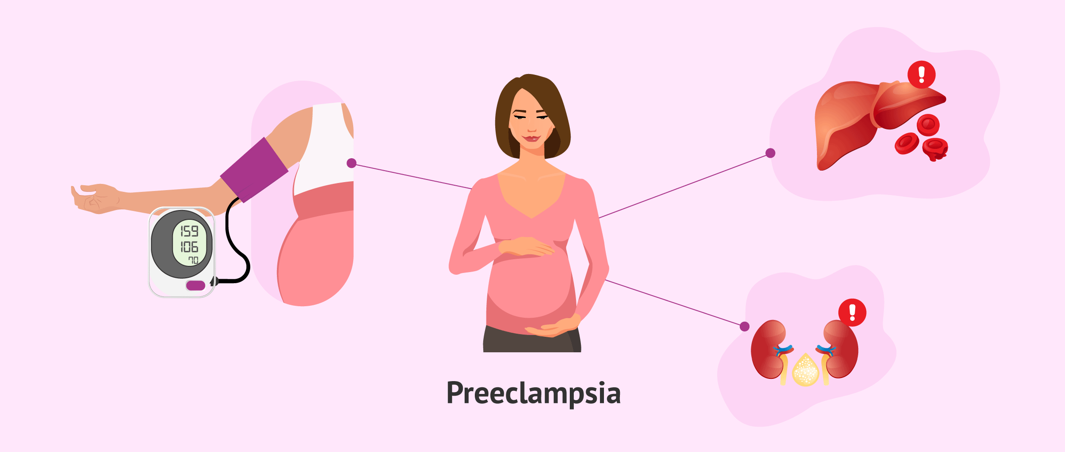
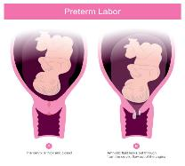
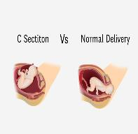
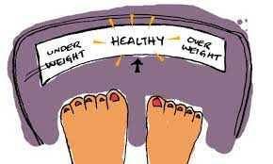
FOCUS AREA
Gestational Diabetes: It is a type of diabetes that can develop during pregnancy in women who don’t already have diabetes. This causes due to lack of insulin due to weight gain.
Pre-Eclampsia: High BP than can happen after 20th week of pregnancy or after giving birth (aka postpartum preeclampsia).Apart from high BP, it can cause organs, like the kidneys and liver, to not work normally.
Pre-Term: When the baby is born before usually before 37 weeks
C-Section: Labor is not progressing well, Baby is in bad position, or the baby is too large for vaginal birth. Heavy Vaginal Bleeding.
Ideal Weight: Weight gained is important during the pregnancy, Is often Body Mass Index(BMI)
Gestational Diabetes
Preeclampsia
Preterm
C section
Ideal weight

Slide 9
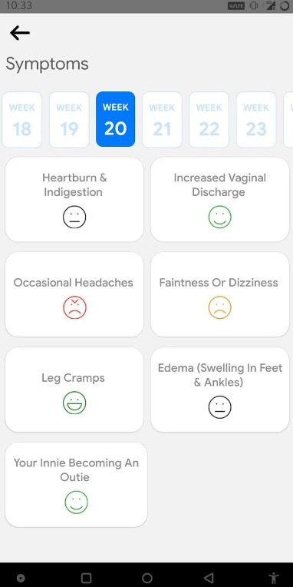
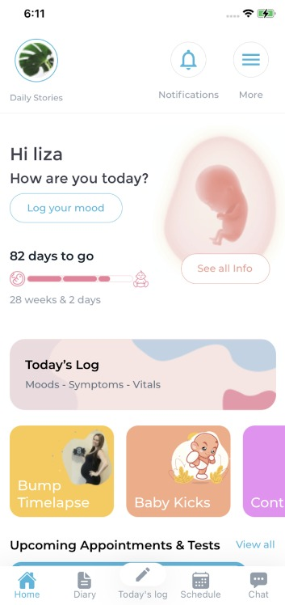
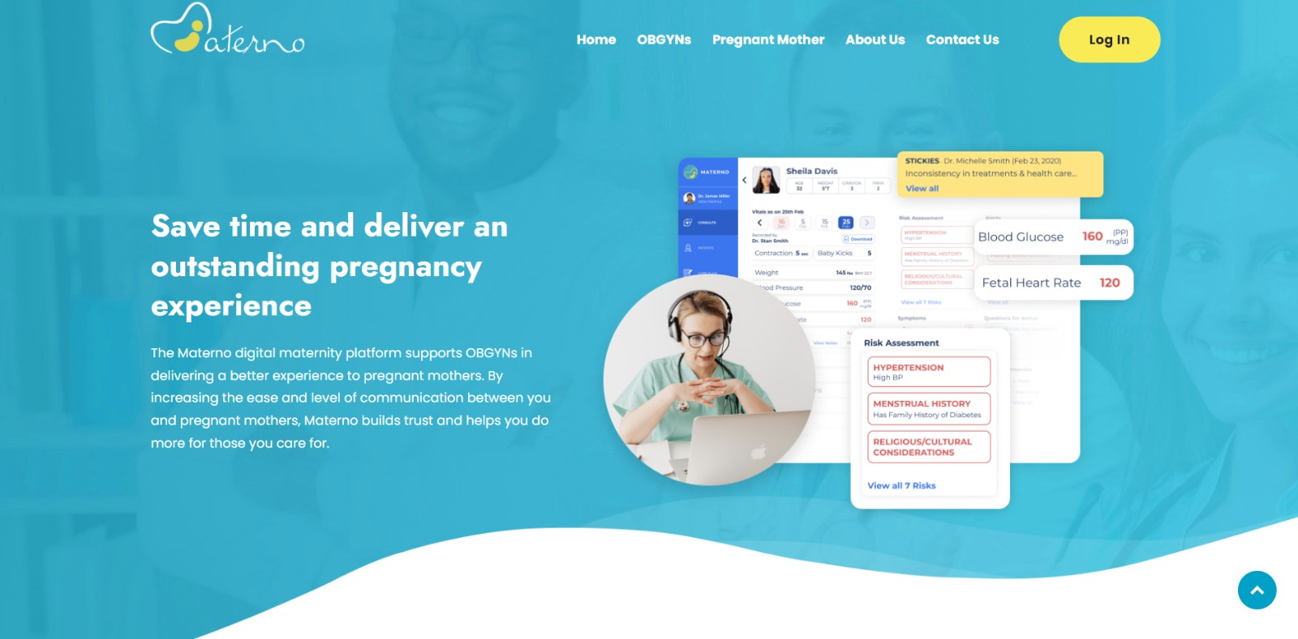
PREVIOUS WORKS
Materno App
Materno is a multifunctional digital platform
It’s a mobile app to ensure the medical records.
It is accessible area for both OBGYN’s and pregnant mothers
Easy to use and book appointments
Easy to follow all the tests and go accordingly
To bring Obstetricians-gynecologists, pregnant mothers all together to ensure safer and better pregnancies
.

Slide 10

DATASETS

Slide 11
DATASETS
Dataset Name: Metronomic Health Dataset
Dataset Owner: Metronomic Health
Dataset Type: CSV
Dataset Size: 14KB
Dataset Access: File from the Dr Sujith Krishnan
Dataset Restrictions: No specific restrictions
Dataset Collection Process: Created synthetic data based on the 98 rows given by Dr Sujith Krishnan
Synthetic Data: 5000 Rows
Analytic/Algorithm that will use dataset: Machine Learning algorithms

Slide 12
METRONOMIC HEALTH DATASET
Patient Id | date_of_birth | medical_condition | co_morbidity | ethnicity
6 | 30/01/1990 | POSTPARTUM | diabetes | Mixed
7 | 22/10/1986 | POSTPARTUM | obesity | Non-Hispanic White
8 | 5/7/1982 | PREGNANCY | obesity | Hispanic and Latino
9 | ######## | PREGNANCY |  | Non-Hispanic White
13 | 16/03/1996 | POSTPARTUM | obesity | Hispanic and Latino
14 | 9/2/1984 | POSTPARTUM | obesity | Black or African
co_morbidity_diabetes | co_morbidity_obesity | ethnicity_Asian | ethnicity_Black or African
1 | 0 | 0 | 0
0 | 1 | 0 | 0
0 | 1 | 0 | 0
0 | 0 | 0 | 0
0 | 1 | 0 | 0
0 | 1 | 0 | 1
0 | 1 | 0 | 0

Slide 13
DATA CLEANING STEPS
One hot encoding
one hot encoding is a process by which categorical variables are converted into a form that could be provided to ML algorithms to do a better job in prediction.
Label encoding
Label encoding is a process of converting categorical data into numerical form, so that it can be used as input for machine learning models.
Null Values
Label encoding is a process of converting categorical data into numerical form, so that it can be used as input for machine learning models.

Slide 14
ONE HOT ENCODING
What is one hot encoding ?
one hot encoding is a process by which categorical variables are converted into a form that could be provided to ML algorithms to do a better job in prediction.
The categorical value represents the numerical value of the entry in the dataset.
This encoding allows machine learning algorithms to use categorical data as input, as most algorithms require numerical data
Why to use one hot encoding ?
one-hot encoding is important because it allows us to convert categorical data into numerical data.
That can be processed by machine learning algorithms, while preserving the information contained in the categorical variable prevents the algorithm from placing undue weight on a particular category.
When to use one hot encoding ?
When the categorical variable does not have an inherent order or hierarchy, such as colors, countries, or genres.
When the categorical variable has a small number of categories, as one-hot encoding can create many additional features, which can be computationally expensive.

Slide 15
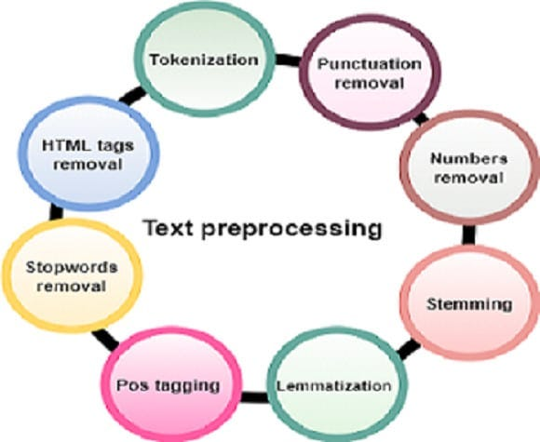
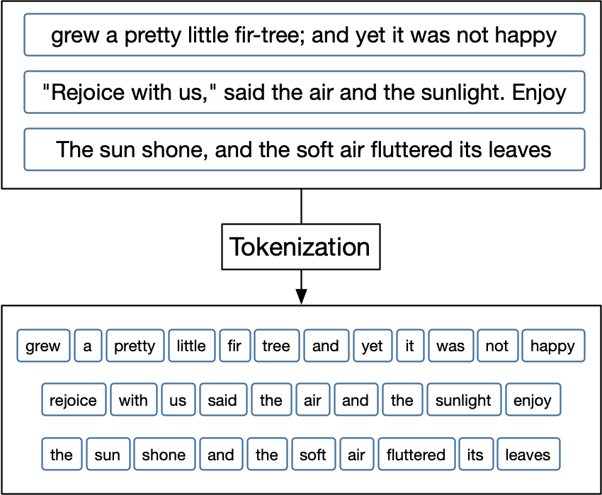
NLP
NLP :Natural Language Processing is a field of artificial intelligence that focuses on the interaction between human language and computers.
Text pre-processing: This step involves cleaning and formatting the raw text data, such as removing punctuation, converting to lowercase, removing stop words, etc.
Tokenization: This is the process of splitting the text into individual words or phrases, called tokens. This step often involves using a tokenizer tool that takes care of the process automatically.

Slide 16

ARCHITECTURE/ANALYSIS
AND ALGORITHMS

Slide 17
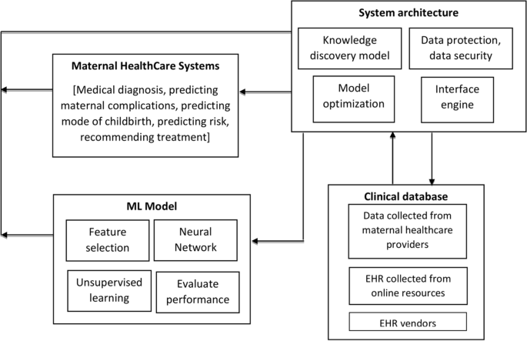
Framework of machine learning for maternal healthcare
Clinical Database: The clinical database serves as the foundation for the predictive model as decisions are made depending on the patients’ information.
System Architecture: KDM is responsible for identifying and discovering meaningful patterns and correlations in EHR, evaluating the performance of the ML model.
ML Model: The central component of the framework is the machine learning model, as this model can assist physicians in determining the pregnancy’s outcome.
Maternal Health Care System: With the evolution of machine learning and data mining in health sectors, researchers should concentrate on how to use ML in maternal sectors
https://bmcpregnancychildbirth.biomedcentral.com/articles/10.1186/s12884-022-04594-2

Slide 18
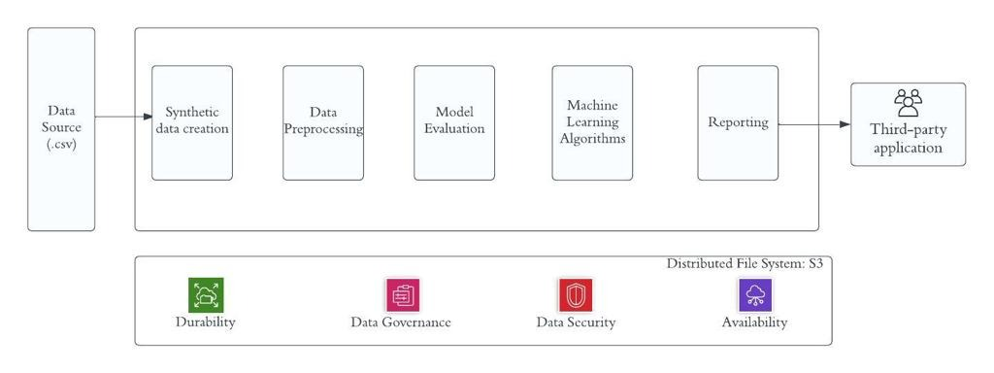
ARCHITECTURE
Data Source : Data source is the origin or location from where the data is collected or acquired for analysis.
Synthetic data collection: Synthetic data collection is the process of generating artificial data that mimics real-world data.
Data Pre-processing : The goal of data preprocessing is to prepare the data for analysis by cleaning, transforming, and reducing its dimensionality.
Model Evaluation : The goal of model evaluation is to determine how well the model can generalize to new, unseen data.
Machine Algorithms: The algorithms are designed to identify patterns and structures in large, complex data sets by using statistical techniques and computational models.

Slide 19
analytic/algorithm Specification
Data Inputs: Data size is 14KB
Data Outputs: using this model can greatly reduce their workload in terms of assessing their patient’s risk level. Moreover, mothers can personally use the models to know their risk level, where they will be able to access this platform.
Hyperparameters: The GridSearchCV method with a k-fold cross-validation will be used, a grid search will be performed for each model based on its performance, reflected by the accuracy..
Algorithms that helps with training: Classification model, Regression model, Random Forest, K-Nearest Neighbors.
Model Tuning: The model tuning is done based on the mean score after completing k-fold cross validation on the rows in the dataset.
Model Training Resources Required: CPU, GPU, cloud based, laptop, memory, etc.
Model Deployment: This study is aimed to build a high-risk pregnancy predictor model.

Slide 20
MODEL TRAINING
Decision Tree :. It is a supervised learning algorithm that uses a tree-like model of decisions and their possible consequences to predict a target variable based on input features.
KNN : It is a non-parametric and lazy learning algorithm, which means that it does not make any assumptions about the underlying data distribution.
SVM : Support vector machine is a popular supervised machine learning algorithm used for classification and regression tasks. It works by finding the optimal hyperplane in a high-dimensional space that maximizes the margin between the classes.
Logistic Regression :Logistic Regression is a statistical method used to analyze the relationship between a dependent variable and one or more independent variables. .

Slide 21

VISUALIZATIONS

Slide 22
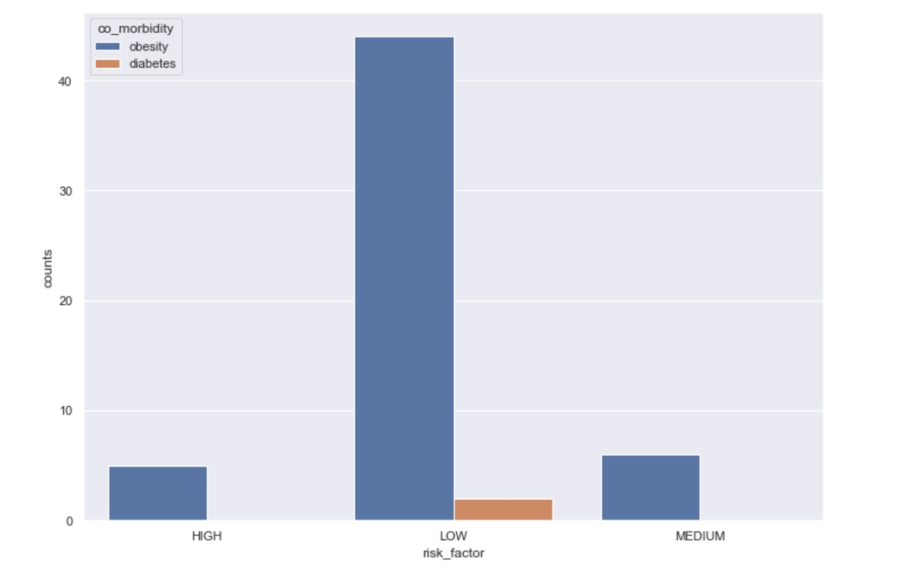
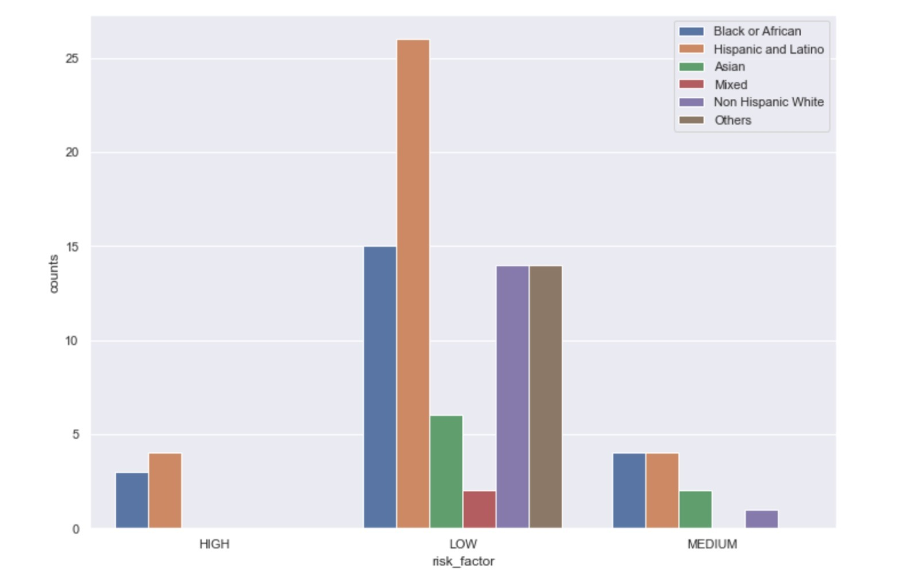
VISUALIZATIONS
Ethnicity vs Risk factor
Co-morbidity Vs Risk factor

Slide 23
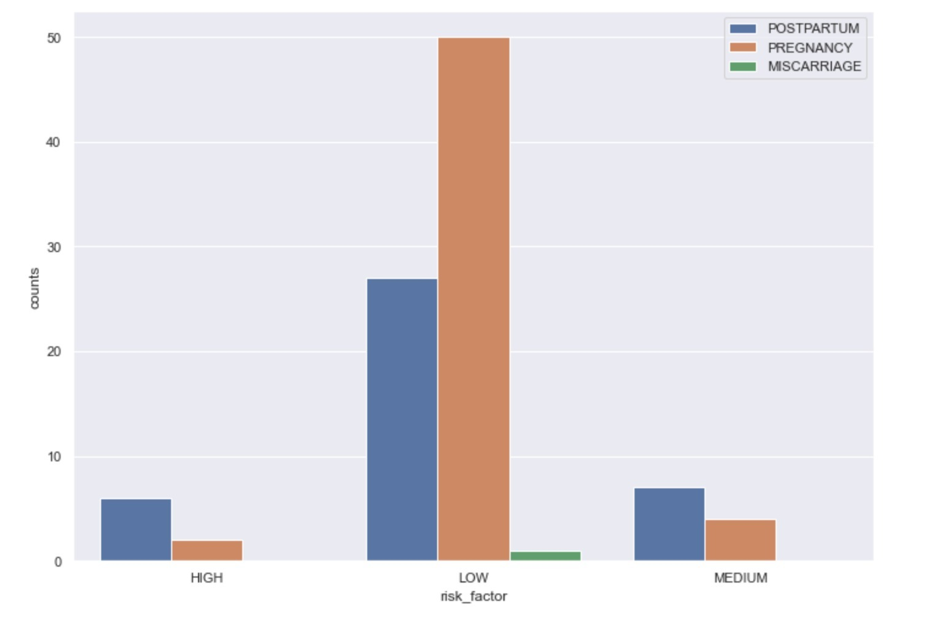
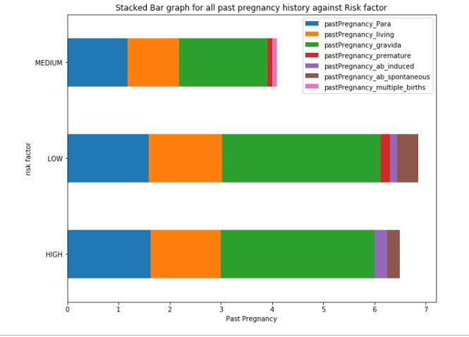
Visualizations
VISUALIZATIONS
Risk Factor findings with respect to pregnancy type
Risk factor findings with respect to past pregnancy history

Slide 24
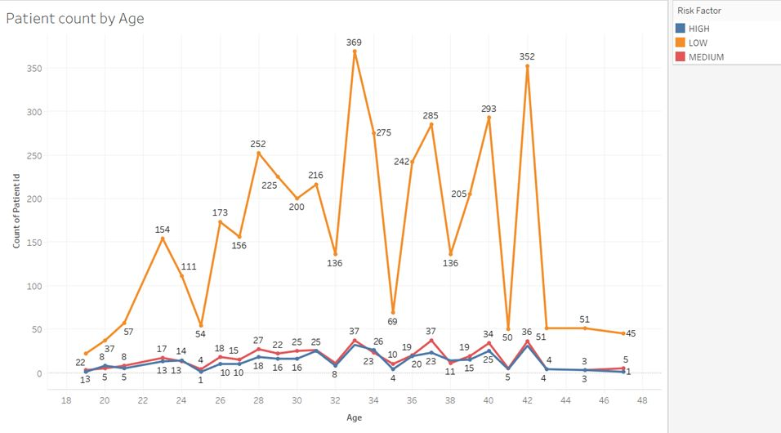
VISUALIZATIONS

Slide 25
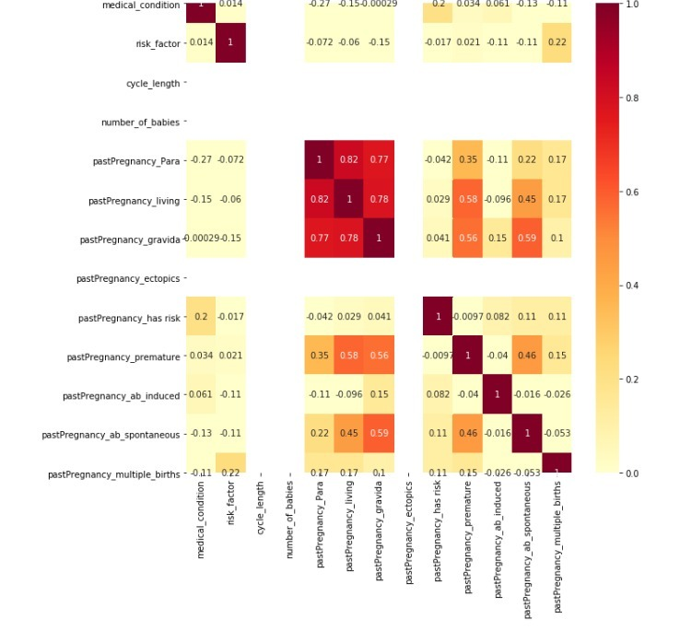
VISUALIZATIONS
Variables that have not affected the risk factors:
Cycle length
No of babies
Past pregnancy ectopic
Variables that have significantly affecting the risk factors:
Past pregnancy multiple births
Past pregnancy premature
Medical condition

Slide 26
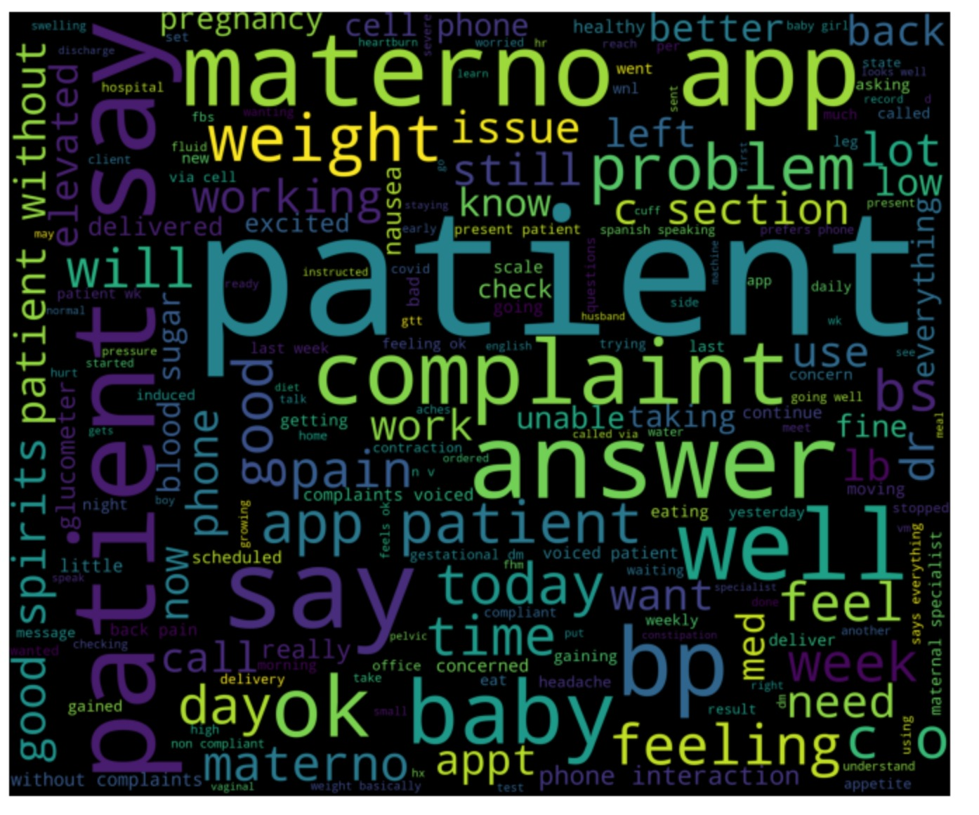
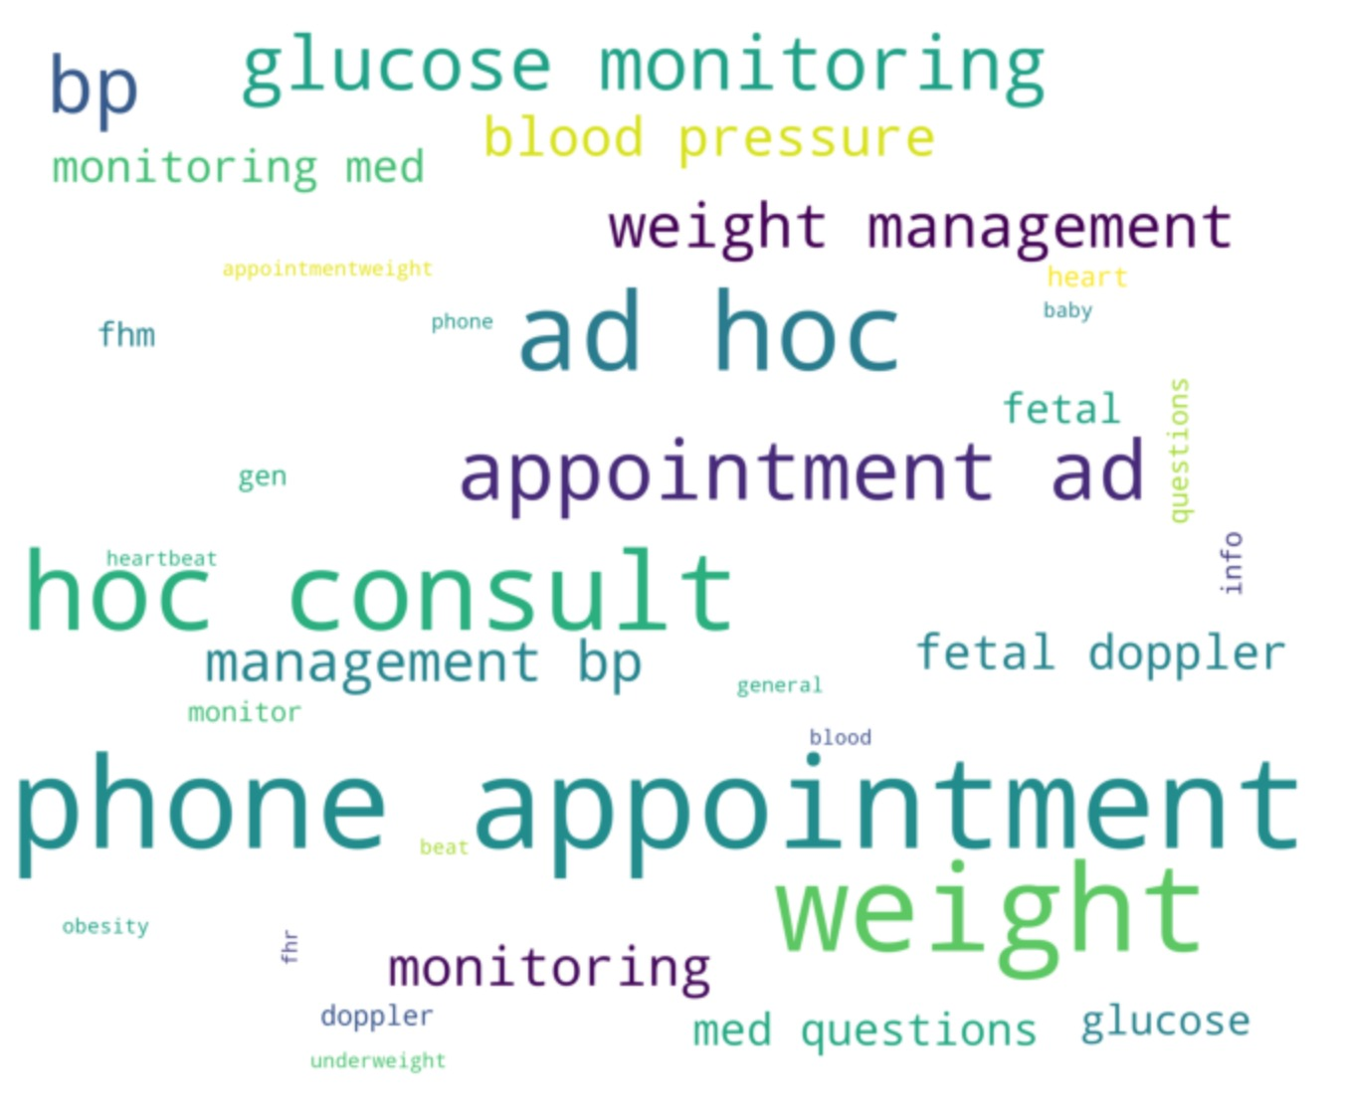
visualizations
Clinical Observations
Appointment Reasons
Clinical observations

Slide 27
ACCURACIES
RISK FACTORS | LOGISTIC CLASSIFICATION | DECISION TREE | SUPPORT VECTOR MACHINE (SVM) | K-NEARSET NEIGHBOR (KNN)
GESTATIONAL DIABETES | 90 | 90 | 90 | 95
PRE-ECLAMPCIA | 90 | 90 | 90 | 95
PRE-TERM | 90 | 85 | 90 | 95
C-SECTION | 90 | 95 | 90 | 95
IDEAL WEIGHT | 90 | 95 | 90 | 95

Slide 28

KEY FINDINGS

Slide 29
KEY FINDINGS
The word cloud modeled from titles and keywords confirm the strong relationships. The highlighted words in the visual representations (slide 26) have more prominence in these studies. Significantly highlighted words in both visualizations include preterm, delivery, cesarean, factors, gestational and pre-eclampsia and risks.
Though datasets were used for each study for different motives there was similarity in how the data was collected and the types of features used. The most used feature categories were different demographic and obstetric characteristics, maternal factors.
Machine Learning has been used mostly in predicting complications in pregnancy, exploring factors responsible for preterm birth, gestational diabetes, c-section, ideal weight, pre-eclampsia. Also, it was evident that different algorithms gave different accuracy in different scopes

Slide 30

FUTURE WORK

Slide 31
FUTURE WORK
Some maternal complications, for example, preterm birth, preeclampsia, gestational diabetes occur frequently during childbirth. In the future, data associated with these complications of symptomatic mothers can be collected and then analyzed using effective machine learning techniques to discover if there are some unknown reasons behind these complications.
Though the study do not present any software framework, desktop, or mobile application. In the future, ML-based applications can be developed for predicting maternal complications Moreover, the usability and usefulness of these software systems can be evaluated to examine how effective they are in aiding doctors in clinical decision-making.

Slide 32

THANK YOU

